Slide 1

Java EE:
Servlets API 4.0
SoftUni Team
Technical Trainers
Software University
http://softuni.bg

Slide 2
Table of Contents
Servlet API 4.0
Tasks
Lifecycle
Architecture
Hibernate
<number>
Notes:
© Software University Foundation – http://softuni.org
This work is licensed under the Creative Commons Attribution-NonCommercial-ShareAlike license.
<number>

Slide 3
Questions
sli.do #java-web

Slide 4

Java Servlets
Overview
Notes:
<number>
© Software University Foundation – http://softuni.org
This work is licensed under the Creative Commons Attribution-NonCommercial-ShareAlike license.

Slide 5


What are Servlets?(1)
Servlets:
Component-based
Platform-independent
Method for building Web based applications
Have access to the entire family of Java APIs
<number>

Slide 6

What are Servlets?(2)
Java Servlets:
Programs that run on a Web or Application server
Middle layer between a requests
Servlets can:
Collect input
Present records from a database or another source
Create web pages dynamically
<number>

Slide 7

Servlets Tasks(1)
Read the explicit data sent by the clients (browsers):
HTML form on a Web page
Applet
Custom HTTP client program
<number>

Slide 8
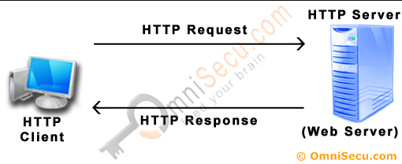
Servlets Tasks(2)
Read the implicit HTTP request data sent by the clients
(browsers):
Cookies
Media types
Compression schemes the browser understands
<number>

Slide 9
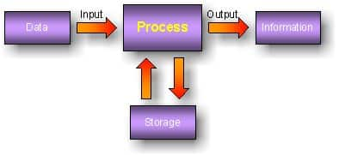
Servlets Tasks(3)
Process the data and generate the results:
Talking to a database
Invoking a Web service
Computing the response directly
<number>

Slide 10



Servlets Tasks(4)
Send the explicit data to the clients (browsers):
Text (HTML or XML)
Binary (GIF images)
Excel
<number>

Slide 11

Servlets Tasks(5)
Send the implicit HTTP response to the clients (browsers):
Telling the browsers or other clients what type of document is
being returned (e.g., HTML)
Setting cookies
Caching parameters
<number>

Slide 12
Servlet Life Cycle
A servlet life cycle:
init() method – initialize servlet
service() method - process client's request
destroy() method - servlet is terminated
<number>

Slide 13

The init() Method
The init() method:
Called only once when the servlet is created
Servlet is created when a user first invokes a URL corresponding to the servlet
<number>

Slide 14
The service() Method
The service() method:
The main method to perform the actual task
Called by the servlet container to:
Handle requests coming from the client
Write response back to the client
Checks the HTTP request type (GET, POST, PUT, DELETE, etc.) and calls the appropriate method – doGet(), doPost(), etc.
<number>

Slide 15
The doGet() Method
A GET request:
Results from:
Normal request for a URL
HTML form that has no METHOD specified
Should be handled by doGet() method
Servlet.java
@WebServlet("/")
public class Servlet extends HttpServlet {
protected void doGet(…) {
// Servlet code
}
}
<number>

Slide 16
The doPost() Method
A POST request:
Results from an HTML form
Should be handled by doPost() method.
Servlet.java
@WebServlet("/")
public class Servlet extends HttpServlet {
protected void doPost(…) {
// Servlet code
}
}
<number>

Slide 17

The destroy() Method
The destroy() method:
Called only once at the end of the lifecycle of a servlet
Gives your servlet chance to:
Close database connections
Halt background threads
Write cookie lists
Hit counts to disk
Perform other such cleanup activities
<number>

Slide 18
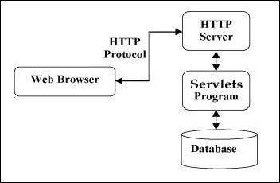
Servlets Architecture
The following diagram shows the position of Servlets in a Web Application:
<number>

Slide 19
Java Servlets
Examples
Notes:
<number>
© Software University Foundation – http://softuni.org
This work is licensed under the Creative Commons Attribution-NonCommercial-ShareAlike license.

Slide 20
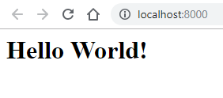
Hello World!
Servlet.java
@WebServlet("/")
public class Servlet extends HttpServlet {
private String message;
protected void init(…) {
this.message = “Hello World!”;
}
protected void doGet(…) {
response.setContentType(“text/html”);
PrintWriter out = response.getWriter();
out.println(String.format(“<h1>%s</h1>”, this.message));
}
}
<number>

Slide 21
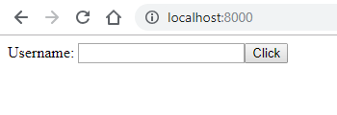
Greeting!(1)
FormServlet.java
@WebServlet("/")
public class FormServlet extends HttpServlet {
private String form;
protected void init(…) {
this.form = "" +
"<form action=\"/greeting\" method=\"post\">" +
"<label>Username: " +
"<input name=\"username\"/></label>" +
"<button>Click</button>" +
"</form>";
}
protected void doGet(…) {
response.setContentType(“text/html”);
PrintWriter out = response.getWriter();
out.println(this.form);
}
}
<number>

Slide 22
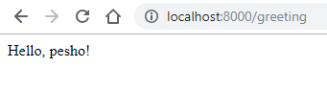
Greeting!(2)
GreetingServlet.java
@WebServlet("/greeting")
public class GreetingServlet extends HttpServlet {
protected void doGet(…) {
response.setContentType(“text/html”);
response.setStatus(200);
}
protected void doPost(…) {
response.setContentType(“text/html”);
PrintWriter out = response.getWriter();
out.println(String.format("Hello, %s!", request.getParameter("username")));
}
}
<number>

Slide 23

Hibernate
Overview
<number>

Slide 24

What is JDBC?
JDBC:
Java Database Connectivity
Provides a set of Java API for accessing the relational databases from Java program
Enables Java programs to:
Execute SQL statements
Interact with any SQL compliant database

Slide 25
What is Hibernate?(1)
Hibernate:
Object-Relational Mapping (ORM) solution for Java
Powerful
High performance
Object-Relational Persistence
Query service
Maps:
Java classes to database tables
Java data types to SQL data types
<number>

Slide 26
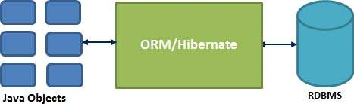
What is Hibernate?(2)
Hibernate:
Sits between traditional Java objects and database server
Handles all the works in persisting objects based on the
appropriate O/R mechanisms and patterns
<number>

Slide 27
Java EE and Hibernate(1)
Hibernate dependency:
Hibernate .jar file: http://central.maven.org/maven2/org/hibernate/hibernate-core/5.4.0.Final/hibernate-core-5.4.0.Final.jar
Put the .jar file into TomEE/lib folder.
pom.xml
<dependency>
<groupId>org.hibernate</groupId>
<artifactId>hibernate-core</artifactId>
<version>5.4.0.Final</version>
</dependency>
<number>

Slide 28
Java EE and Hibernate(2)
persistence.xml
<?xml version="1.0" encoding="UTF-8"?>
<persistence xmlns:xsi="http://www.w3.org/2001/XMLSchema-instance"
xmlns="http://xmlns.jcp.org/xml/ns/persistence"
xsi:schemaLocation="http://xmlns.jcp.org/xml/ns/persistence http://xmlns.jcp.org/xml/ns/persistence/persistence_2_1.xsd" version="2.1">
<persistence-unit name="soft_uni" transaction-type="RESOURCE_LOCAL">
<properties>
<property name = "hibernate.connection.url" value="jdbc:mysql://localhost:3306/soft_uni_db?useSSL=false&amp;createDatabaseIfNotExist=true&amp;serverTimezone=UTC"/>
<property name = "hibernate.connection.driver_class" value="com.mysql.jdbc.Driver"/>
<property name = "hibernate.connection.username" value="root"/>
<property name = "hibernate.connection.password" value="*****"/>
<property name = "hibernate.dialect" value="org.hibernate.dialect.MariaDBDialect"/>
<property name = "hibernate.hbm2ddl.auto" value="update"/>
<property name = "hibernate.show_sql" value = "true" />
<property name = "hibernate.format_sql" value = "true" />
</properties>
</persistence-unit>
</persistence>
<number>

Slide 29




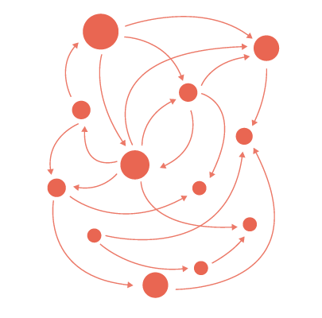
Summary
Java Servlets:
Servlets provide a component-based,
platform-independent method for
building Web based applications
Hibernate:
Hibernate is an Object-Relational
Mapping (ORM) solution for Java
<number>

Slide 30
https://softuni.bg/trainings/courses
Notes:
© Software University Foundation – http://softuni.org
This work is licensed under the Creative Commons Attribution-NonCommercial-ShareAlike license.
<number>

Slide 31













SoftUni Diamond Partners

Slide 32




SoftUni Organizational Partners

Slide 33




Trainings @ Software University (SoftUni)
Software University – High-Quality Education and Employment Opportunities
softuni.bg
Software University Foundation
http://softuni.foundation/
Software University @ Facebook
facebook.com/SoftwareUniversity
Software University Forums
forum.softuni.bg
Notes:
© Software University Foundation – http://softuni.org
This work is licensed under the Creative Commons Attribution-NonCommercial-ShareAlike license.
<number>

Slide 34

License
This course (slides, examples, demos, videos, homework, etc.) is licensed under the "Creative Commons Attribution-NonCommercial-ShareAlike 4.0 International" license
<number>
Notes:
© Software University Foundation – http://softuni.org
This work is licensed under the Creative Commons Attribution-NonCommercial-ShareAlike license.
<number>

